Slide 1
Smart Home Energy Advisor Agent
CAPSTONE PROJECT
Presented By:
1. Ashwini Panicker- MVLU- IT (graduated)

Slide 2

OUTLINE
Problem Statement (Should not include solution)
Proposed System/Solution
System Development Approach (Technology Used)
Algorithm & Deployment
Result (Output Image)
Conclusion
Future Scope
References

Slide 3
PROBLEM STATEMENT
A Smart Home Energy Advisor Agent acts like your personal electricity manager. It takes information from your smart meter and appliances, analyzes power usage, and gives you tips to save energy. The agent can answer questions like "Why is my bill so high this month?" or "What time should I run the washing machine to save money?". It uses AI to understand consumption patterns and provide simple recommendations.

Slide 4
PROPOSED SOLUTION
To support energy conservation and provide personalized energy management, this project proposes a Smart Home Energy Advisor chatbot using AI and IBM Cloud services. The chatbot analyzes household energy usage data and provides actionable insights to reduce electricity costs and improve consumption behavior.
Data Collection:
Simulate or collect smart meter data including total kWh usage, appliance-wise consumption, and time-of-day usage.
Use realistic patterns to reflect seasonal changes, peak/off-peak usage, and appliance behavior.
Data Preprocessing:
Clean and structure the usage data for analysis.
Segment usage by appliance and time window (peak/off-peak) to enable meaningful insights.
AI Model Integration:
Use the IBM Watsonx Granite model for natural language understanding and generating responses.
Embed a system prompt to enable the model to act as an energy advisor.
Response Logic & Evaluation:
Test the chatbot with queries like “Why is my bill high?” or “When should I run the washing machine?”
Evaluate whether the responses are personalized, helpful, and data-aware.
Result Interpretation:
Highlight the chatbot’s ability to identify high-usage appliances, peak-hour habits, and inefficient patterns.
Use example outputs to visualize how users can save energy and reduce bills.

Slide 5
SYSTEM APPROACH
The "System Approach" section outlines the overall strategy and methodology for developing and implementing the rental bike prediction system. Here's a suggested structure for this section:
System requirements:
Platform: IBM Cloud
Tools: Watsonx.ai Studio (Granite AI model), IBM Cloud Object Storage
Interface: AI Chatbot Agent

Slide 6
ALGORITHM & DEPLOYMENT
Algorithm Selection:
We used the IBM Watsonx Granite AI model, a large language model (LLM), ideal for understanding user queries and generating personalized energy-saving responses. It was selected for its ability to interpret natural language and analyze contextual data.
Data Input:
The agent uses user-provided data such as:
Total energy usage (kWh)
Appliance-wise consumption
Peak vs off-peak usage times
Monthly usage comparisons
Training Process:
The LLM is pre-trained by IBM; no custom training was required.
We used prompt engineering to guide the AI’s behavior and simulate data-based reasoning.
Prediction Process:
When a user inputs their data and a question (e.g., "Why is my bill high?"), the AI analyzes patterns, compares past and present usage, and outputs energy-saving tips or appliance-level insights.

Slide 7
RESULT
We successfully built a Smart Energy Advisor chatbot using IBM Watsonx Granite AI.
The agent analyzes user-provided energy data (like total kWh, appliance usage, and peak hours) and gives personalized responses to questions such as:
“Why is my bill high?” and “When should I run the washing machine?”
The chatbot responds intelligently using prompt-based reasoning and helps users make better energy decisions.

Slide 8
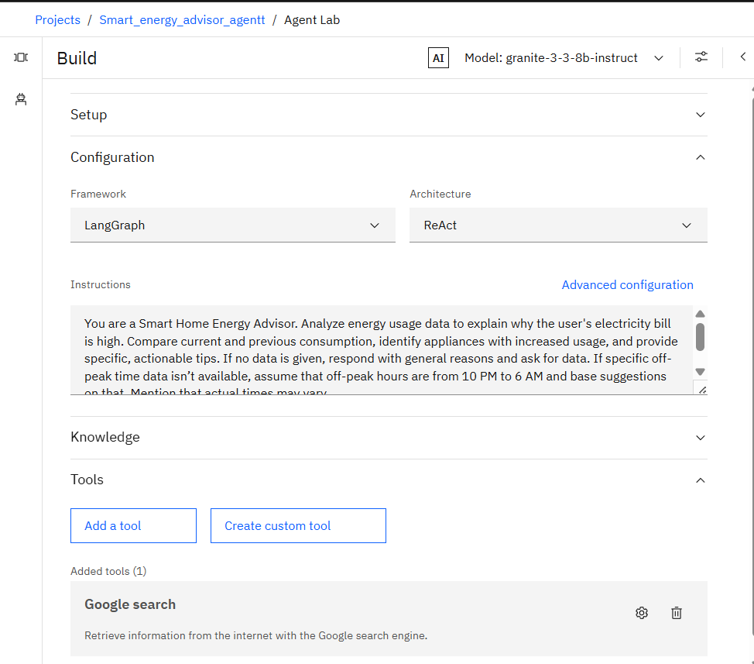
RESULT

Slide 9
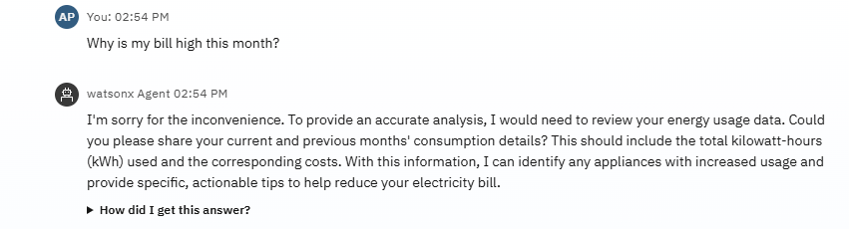
RESULT

Slide 10
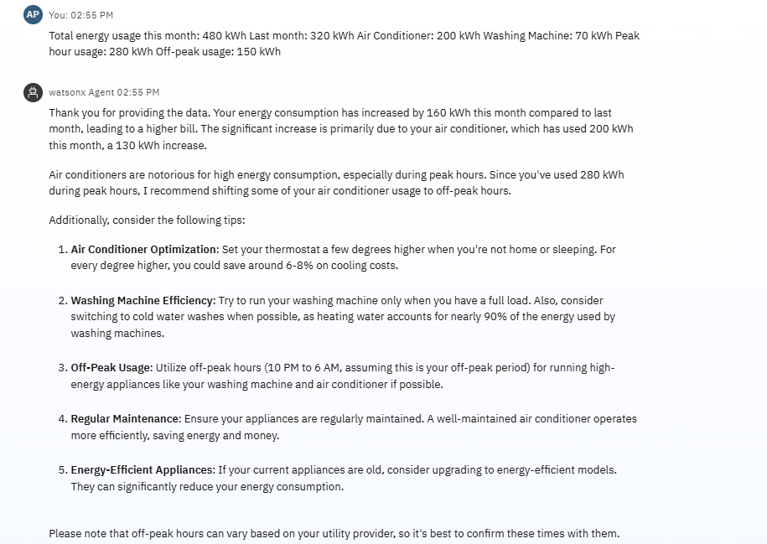
RESULT

Slide 11
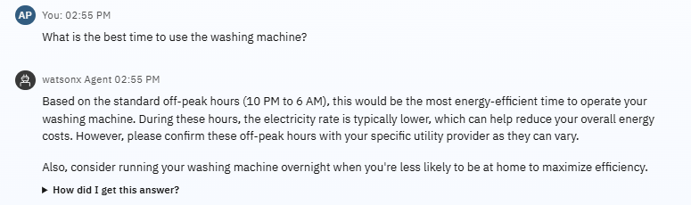
RESULT

Slide 12
CONCLUSION
The Smart Home Energy Advisor demonstrates how AI can help users understand and manage their electricity usage.
By leveraging IBM Watsonx Granite AI, the chatbot provides personalized, data-driven advice to reduce energy costs and promote efficient consumption.
This solution supports sustainable living through intelligent home automation.

Slide 13
FUTURE SCOPE
Real-time Smart Meter Integration: Connect with IoT-based smart meters for live energy monitoring.
Voice Assistant Support: Integrate with Alexa, Google Assistant for voice-based energy advice.
Dynamic Tariff Alerts: Notify users about peak/off-peak pricing changes from utility providers.
Mobile App Deployment: Offer a user-friendly mobile app for on-the-go energy insights.
Personalized Energy Goals: Set and track monthly consumption targets for sustainable living.

Slide 14
REFERENCES
IBM, “watsonx.ai – Build, Tune, and Deploy Foundation Models,” IBM. [Online]. Available: https://www.ibm.com/products/watsonx-ai
(Used for building the AI agent with Granite model)
IBM, “Granite Foundation Models,” IBM Blog. [Online]. Available: https://www.ibm.com/blog/announcing-granite-models
(Describes the AI model you used for natural language responses)
IBM, “IBM Cloud Lite,” IBM. [Online]. Available: https://www.ibm.com/cloud/free
(Used as the platform to host your project)
IBM Documentation – Watsonx.ai Studio
(Used to develop, test, and run the chatbot interface)

Slide 15
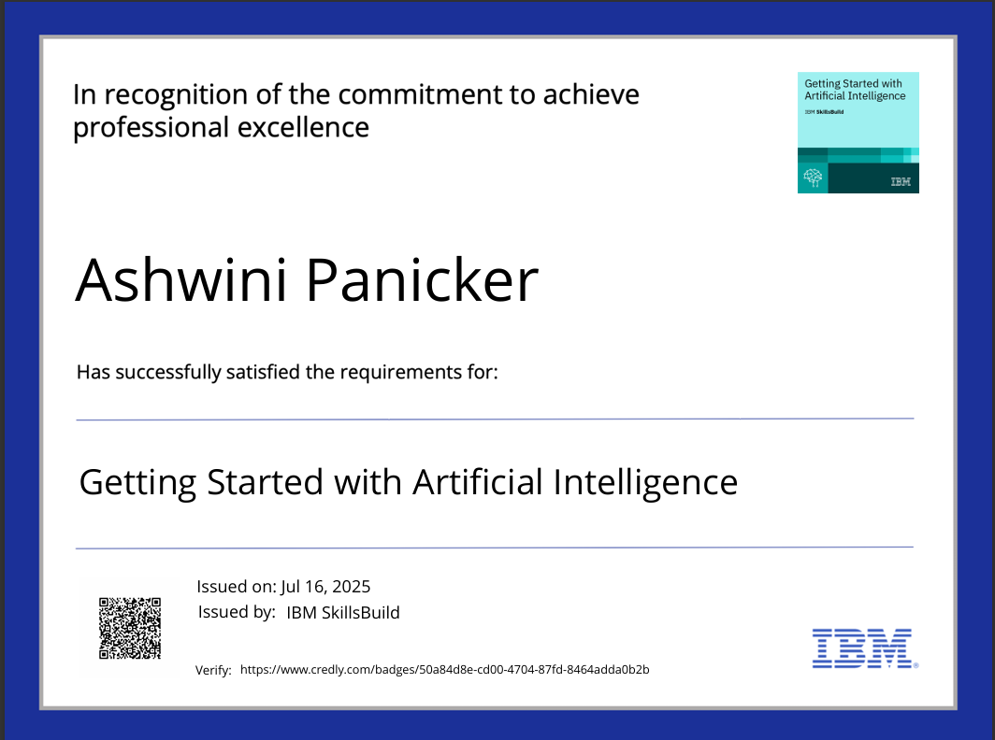
IBM CERTIFICATIONS

Slide 16
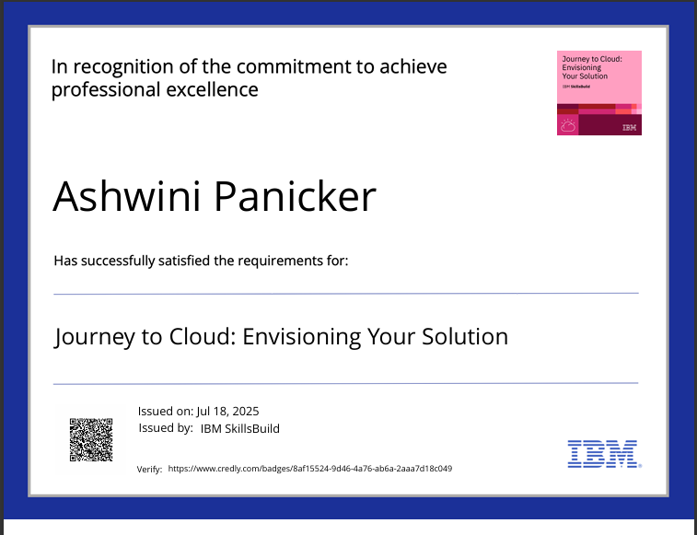
IBM CERTIFICATIONS

Slide 17
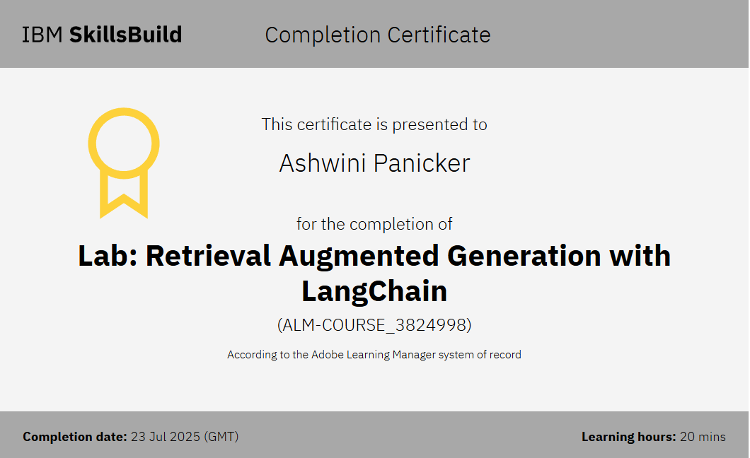
IBM CERTIFICATIONS

Slide 18
THANK YOU

